Slide 1
BPMN Fundamentals: 3. BPMN Simulation
Romi Satria Wahono romi@romisatriawahono.net http://romisatriawahono.net/bpmn WA: +6281586220090

Slide 2

Romi Satria Wahono
SD Sompok Semarang (1987)
SMPN 8 Semarang (1990)
SMA Taruna Nusantara Magelang (1993)
B.Eng, M.Eng and Ph.D in Software Engineering from Saitama University Japan (1994-2004) Universiti Teknikal Malaysia Melaka (2014)
Research Interests: Software Engineering, Machine Learning
Founder dan Koordinator IlmuKomputer.Com
Peneliti LIPI (2004-2007)
Founder dan CEO PT Brainmatics Cipta Informatika

Slide 3
Course Outline
Introduction
BPMN Elements
3.1 Swimlane
3.2 Connecting Objects
3.3 Flow Objects
3.4 Artifacts
BPMN Simulation
BPMN Refactoring
BPMN Guide and Examples

Slide 4
3. BPMN Simulation
3.1 Introduction to Simulation
3.2 Process Validation
3.3 Time Analysis
3.4 Resource Analysis
3.5 Calendar Analysis

Slide 5
3.1 Introduction to Simulation

Slide 6
What is Simulation
Simulation is a tool:
to evaluate the performance of a model, under different configurations and over long periods of real time
to reduce the chances of failure to meet specifications, to eliminate unforeseen bottlenecks
to prevent under or over-utilization of resources (including people and money)
to optimize system performance
Simulation requires a clear objective to get maximum value for effort
This objective strongly influences the level of detail in the required data

Slide 7
What is Simulation
Randomness is simulated by:
Using probabilities for sequence flows and token routing
Using statistical distributions to reflect variability in process times of activities etc
To make sure results are valid:
the simulation needs be run for long enough to yield random behavior without chance
Provision should be made to compare results from the same scenario, but different run lengths or replications
The required run length to yield usable outcomes depends on the process model structure, amount of variability and the objective
Consequently, a single recommended run length cannot be provided
A replication shares the same scenario configuration and runs for the same length of time, but uses an alternative random stream

Slide 8
Simulation in Bizagi
Bizagi Modeler allows simulation your business processes under the BPSim (Business Process Simulation) to support decision making and boost their continuous improvement
To start using simulation in Bizagi all you need is a complete Process model
otherwise, it will not be able to be simulated
For a complete simulation analysis we recommend using four levels:
Level 1 -Process Validation
Level 2- Time Analysis
Level 3 - Resources Analysis
Level 4 - Calendars Analysis

Slide 9
Simulation in Bizagi
Each subsequent level incorporates additional information that adds more complexity, providing a coherent analysis of your processes
Levels are not interdependent, you may start at any level if you hold the required process data
By default the Simulation mode will start at Level one, the first time a Simulation is run for the process model
It is best practice to start simulation at level one, and progress one level at a time
It is possible to move between levels at any time
For each simulation level follow these steps:
Collect process data for the simulation
Add the data to the relevant shapes in the diagram
Interpret and present the outcomes

Slide 10
Supported Elements and Diagrams
The following BPMN elements are not supported by the simulation engine:
Multiple events: Start, Intermediate and End
Complex gateways
Event based gateways followed by none intermediate events or tasks.
Multiple instance tasks
Multiple instance Sub-processes
The following diagrams are not supported by the simulation engine:
BPMN Choreography diagrams
BPMN Conversation diagrams
Transactional process
Ad Hoc process

Slide 11
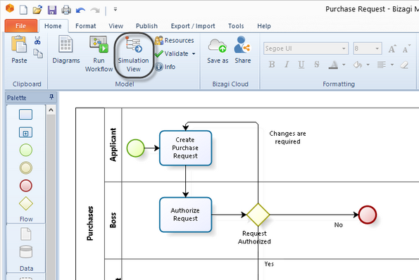
How to Create and Run Simulation Models? 1. Click Simulation View to simulate your process model

Slide 12
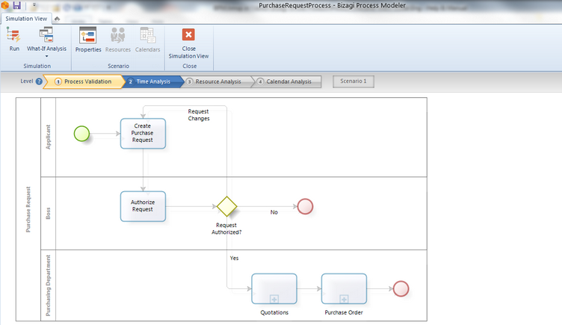
How to Create and Run Simulation Models? 2. The shapes that require information will be highlighted

Slide 13
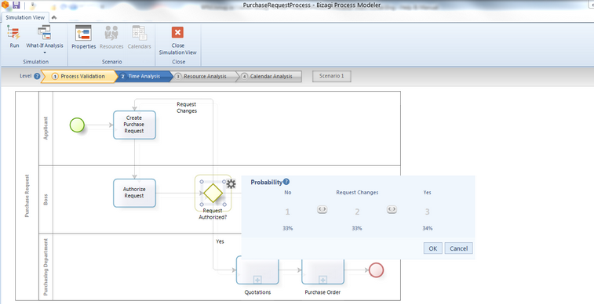
How to Create and Run Simulation Models? 3. Select highlighted shape in turn and enter the information

Slide 14
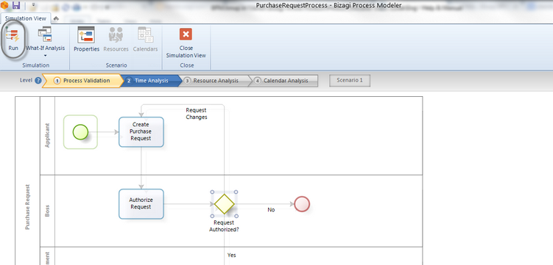
How to Create and Run Simulation Models? 4. Click Run to launch the Process Simulation

Slide 15
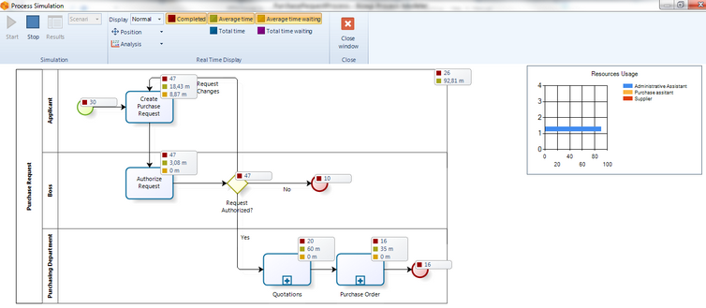
How to Create and Run Simulation Models? 5. Click Start to run the simulation

Slide 16
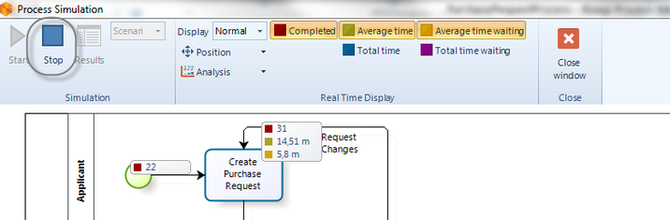
How to Create and Run Simulation Models? 6. Click Stop to stop the simulation

Slide 17
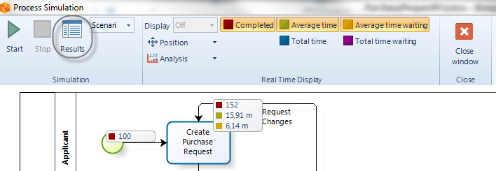
How to Create and Run Simulation Models? 7. Click Results to view the outcomes

Slide 18
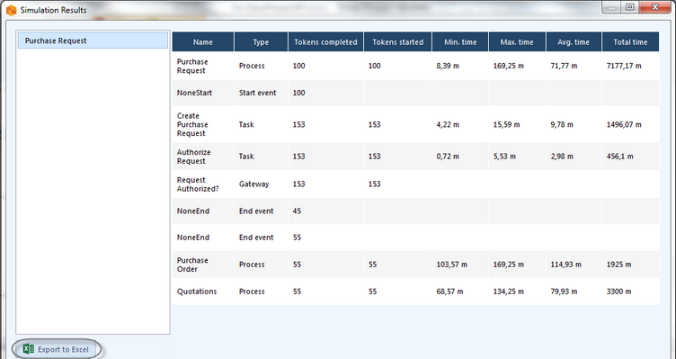
How to Create and Run Simulation Models? 8. Click the Export to Excel button

Slide 19
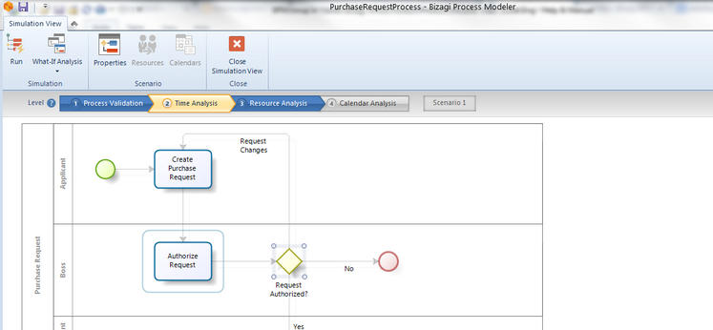
How to Create and Run Simulation Models? 9. Process to the next level and repeat step 1-8

Slide 20
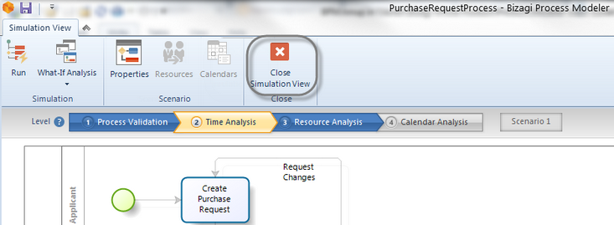
How to Create and Run Simulation Models? 10. Click Close Simulation View to return

Slide 21
Simulation Levels
Bizagi Simulation comprises of four levels
Each subsequent level incorporates additional information exhibiting more complexity than the preceding one, thereby providing a detailed analysis of your processes
Levels are not interdependent, you may start at any level if you hold the required process data

Slide 22
Level 1 - Process Validation
The first and most basic simulation level to evaluate the structure of the process diagram
Data:
It requires estimated percentage splits of sequence flows to provide a basis for routing
It also needs the value of the trigger counter contained in the Start Event shape
Results:
The outcomes show all paths activated during the execution and whether all tokens actually finished
It evaluates how many tokens passed through each Sequence Flow, Activity and End Event

Slide 23
Level 2 – Time Analysis
Second level of simulation to measure the end-to-end process time
Data:
Apart from the data entered in Process Validation, estimated timings (service times) of each activity and the interval time between token generation is required
This data can either be constant or samples from statistical distributions
Results:
The results show process throughput times for tokens, presented as minimum, maximum, mean and sum (total of all processing times)
Similar results can be presented for individual key activities

Slide 24
Level 3 – Resource Analysis
Predicts how the process will perform with different levels of resources. This level of detail provides a reliable estimate of how the process will perform in operation
Data:
In addition to the data entered in Time Analysis, this level includes the definition of resources (and/or roles): how many are available and where they are used
Due to the inclusion of resources, the activity times should be adjusted to represent the actual work time; delay due to unavailability of staff will be explicitly indicated
Results:
The structure of the results is similar to Time Analysis
The time spent, the time spent busy or idle for each type of resource is presented
This level assume an unlimited number of resources

Slide 25
Level 4 – Calendar Analysis
Includes calendar information that reflects the process performance over dynamic periods of time, such as shifts, days schedules or weeks
By default Bizagi includes a chosen calendar that works 24/7
If no calendars are defined, Bizagi will assume that the defined Resources will always be available
Data:
Apart from the data entered in Resource Analysis, it includes the definition of resource calendars
Results:
The structure of the results is similar to Resource Analysis

Slide 26
Case Study: Patient Assistance
A call center receives a report of an emergency. A call center agent enters details on the person affected, the symptoms and the physical address
A qualified nurse classifies the emergency according to its severity
Green: Low severity. The patient can be easily stabilized
Yellow: Medium severity. The patient requires special attention but can be stabilized at the place of emergency
Red: High severity. The patient must be collected and taken to the nearest hospital
According to the priority assigned, the Emergency attendance department presents a different level of response
Green: This triage is assisted by a quick response vehicle carrying two people: a paramedic and a doctor
Yellow: This triage is assisted by a basic ambulance having a doctor, nurse and a paramedic on Board
Red: This triage is assisted by a fully equipped ambulance holding two doctors, a nurse and a paramedic
If the emergency is green or yellow, the process finishes once the response team arrives at the at the place of emergency
If the emergency is red, the fully equipped ambulance transfers the patient to the nearest hospital
During the transfer a nurse carries out the necessary paperwork to ensure quick admittance
When the patient arrives at the hospital with the necessary paperwork, the receptionist will be able to admit the patient quickly and provide medical assistance immediately
This process must be carefully analyzed in order to reduce the time between receiving the request and providing medical assistance

Slide 27
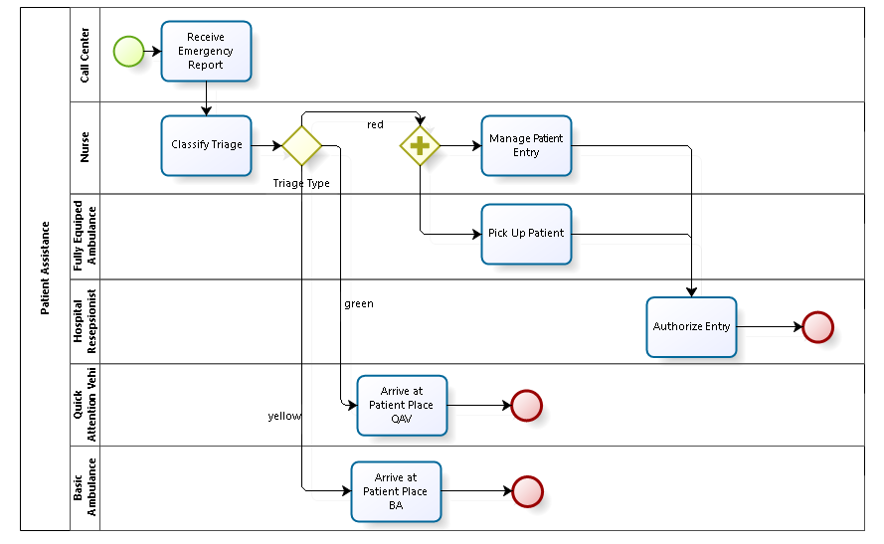
Case Study: Patient Assistance

Slide 28
3.2 Process Validation

Slide 29
Overview
The first level of the simulation validates the Process Model, making sure the process passes through all the sequence flows, and behaves as expected
Resources, processing times and costs are not included in this level
Such parameters will be included later in subsequent levels
When validating a Process Model the simulation results will show if:
Gateways are synchronized
Messages are synchronized
Decisions probabilities are correctly assigned
Routing behaves as expected
All tokens have ended
Bizagi offers real-time animation of simulations to easily identify problems. The Results report will show the behavior during execution

Slide 30
1. Defining the Input Data Required for This Level
In the Process Validation level you will note that only Start Events and Gateways are enabled for editing
For this level you need to define:
Max.arrival count:
Define the number of token instances the process will generate
We recommend defining a large enough number (at least 1000) to allow the execution to stabilize and present reliable outcomes
Select the Start Event of the process and click the Gear icon on the pie menu. Enter the Max.arrival count in the pop-up window
Gateways routing:
Inclusive and exclusive Gateways have activation probabilities
Probabilities are values between 0 and 100%
Select the Gateway and click the scroll arrow icons (icon) to set the probabilities.

Slide 31
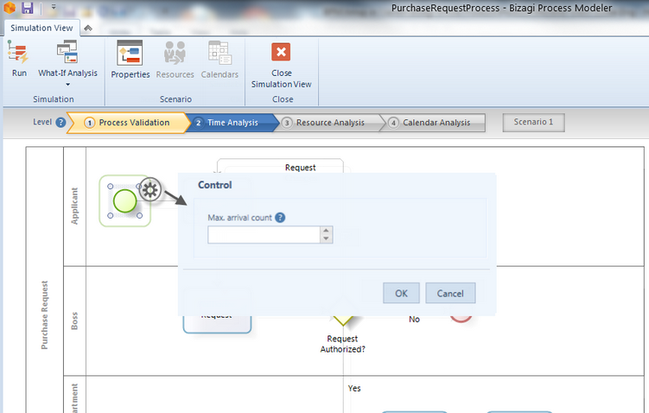
Max.arrival count

Slide 32
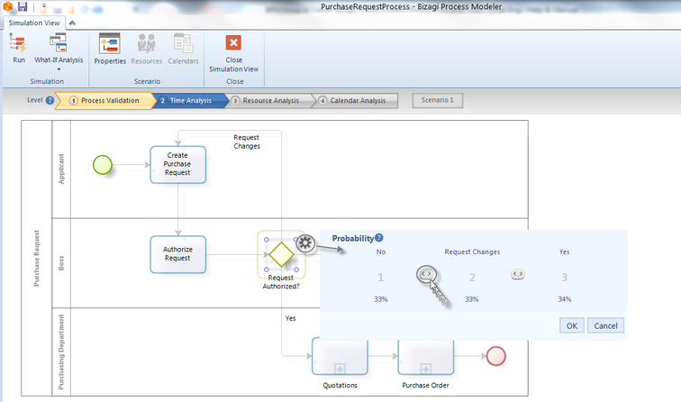
Gateways routing

Slide 33
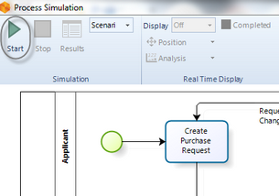
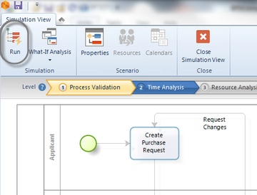
2. Running the simulation
Once the required data for this level have been defined, click the Run button to execute the simulation
In the new window, click Start to run the simulation

Slide 34
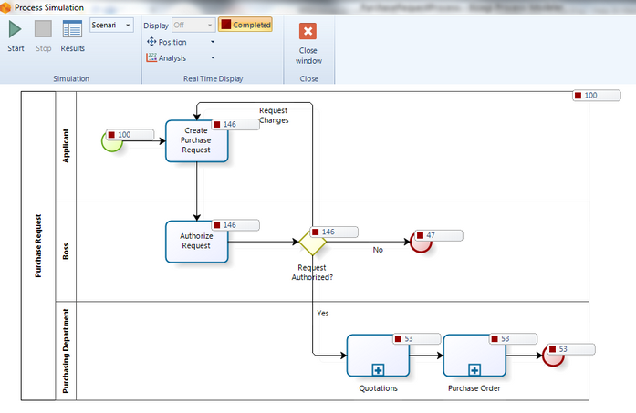
Analysis Data Display
Number of completed tokens
Number of token instances created
Number of instances that activate each shape
Number of finished instances

Slide 35
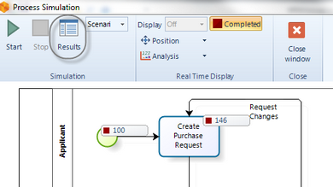
3. Results
When the simulation is finished, view the results by selecting the Results option

Slide 36
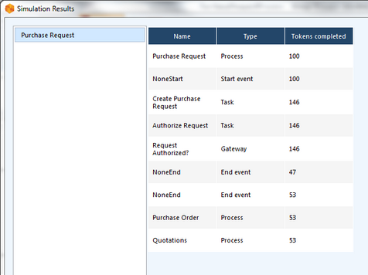
Result Display
Name: Identifies the specific BPM shape for which the results are displayed
Type: Identifies the element type of the BPM shape
Tokens completed: Indicates how many tokens were processed (instances) during the execution of the simulation

Slide 37
Case Study: Process Validation for Patient Assistance

Slide 38
Case Study: Patient Assistance

Slide 39
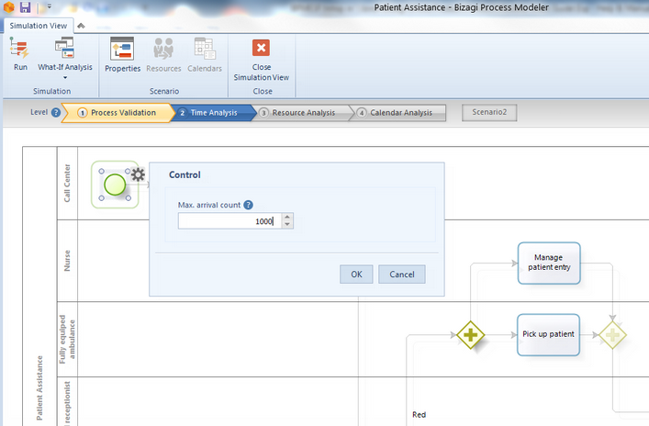
1. Set the Max. Arrival Count = 1000

Slide 40
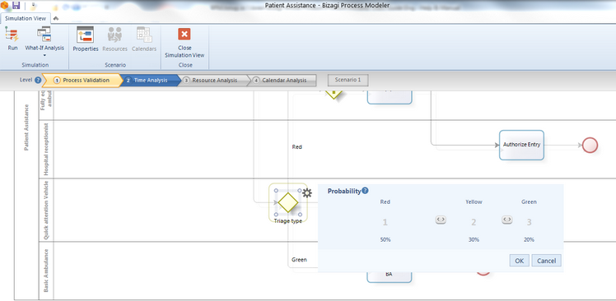
2. Define the Probabilities for All Outgoing Paths of the Gateway
Suppose the emergency department has estimated, based on historical data, that the probabilities for the different sequence flows are:
Green: 20%
Yellow: 30%
Red: 50%
Define each probability for the Gateway named Triage type.

Slide 41
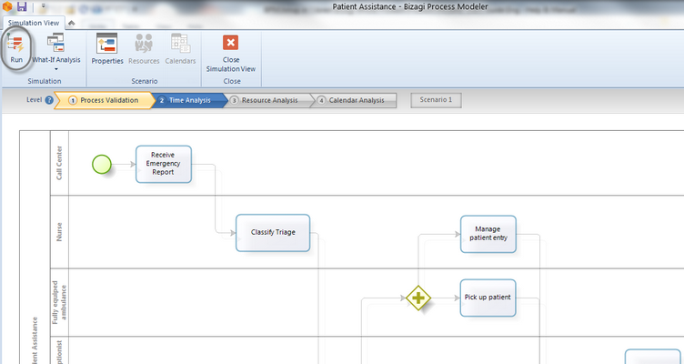
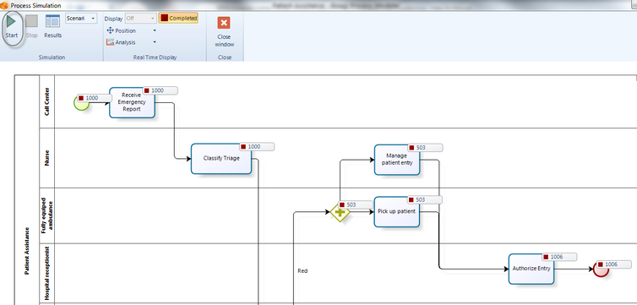
3. Click the Run and Start button

Slide 42
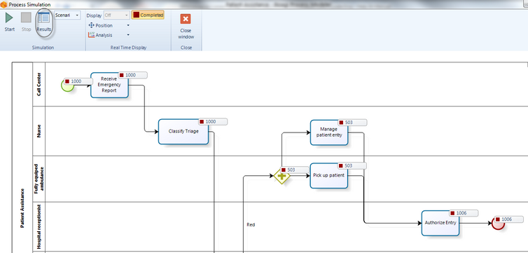
When the Simulation is Complete, Select Results

Slide 43
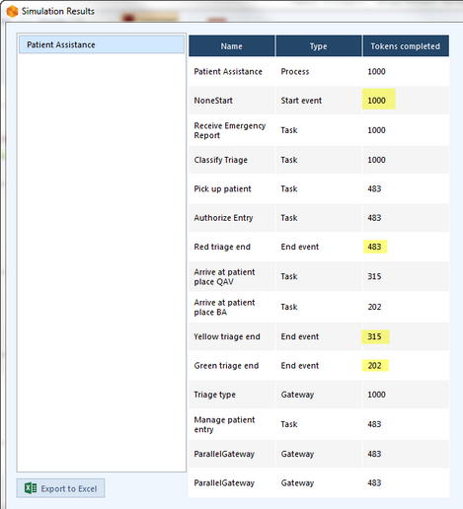
4. Analyzing the Results
Analyzing the results we conclude that something is wrong:
The number of tokens (1000) created at the Start Event of the process differs to the sum of tokens completed at the End Events (1006+311+186)
Can you identify what is wrong in the flow?

Slide 44
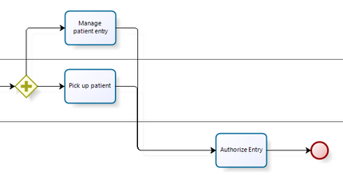
Problem
If you watch the diagram carefully, you will see there is no point of convergence, that is, no shape has been defined to synchronize the paths that exit the Parallel Gateway

Slide 45
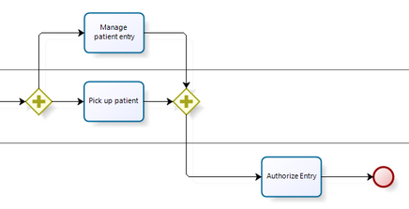
5. Solution
It is necessary to merge the outgoing flows into a single flow before the token continues to the next activity
To do this, include a Parallel Gateway (as a convergence element) to synchronize them

Slide 46
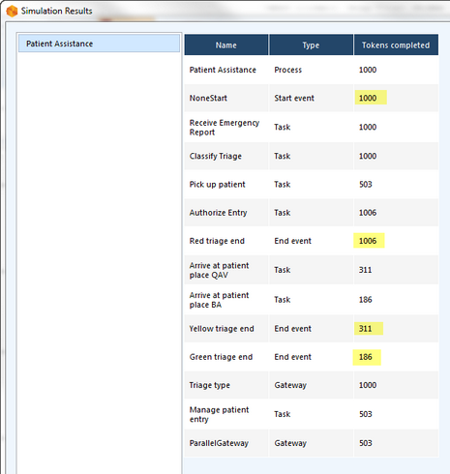
Solution
Once the change is done, Run the simulation again
Looking at the new results we can see that all is working as expected:
The number of tokens created (1000) is equal to the sum of tokens completed (483+315+202)
In addition, each token is passed correctly to the triage based on the probabilities defined

Slide 47
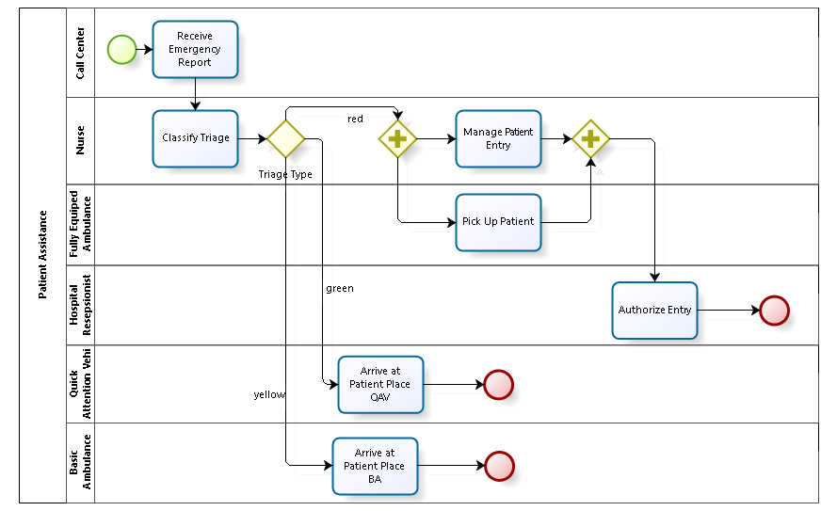
Case Study: Patient Assistance

Slide 48
3.3 Time Analysis

Slide 49
1. Defining the input data required for this level
Arrival interval time:
Defines the time interval between token instances generation
Instances will be created until the max.arrival count is reached
This applies to Start Events, Activities that start processes or Timer Events
Select the Start Event of the process and click the Gear icon on the pie menu. Set the value for the control
One option is to define the arrival interval time as a constant by entering a value. The time units for this value are defined in the scenario´s configuration

Slide 50
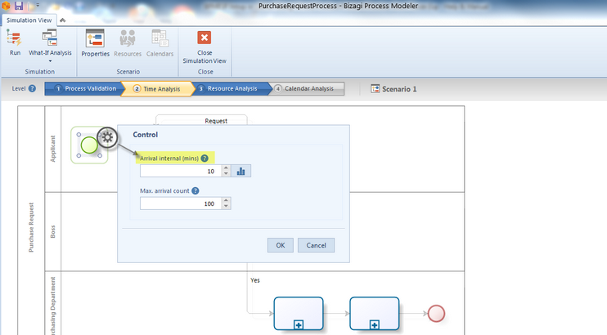
Arrival Interval Time

Slide 51
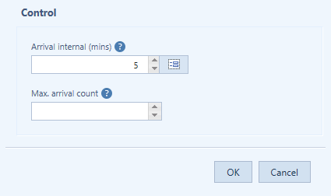
Arrival Interval Time
In the following image tokens instances are generated every 5 minutes

Slide 52
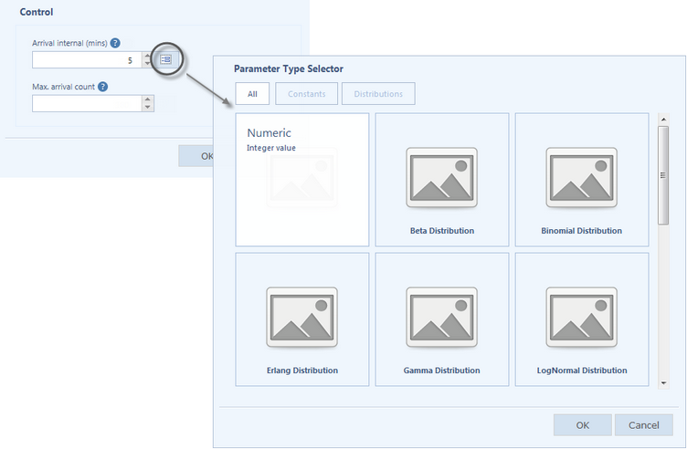
Arrival Interval Time - Statistical Distribution
Alternatively, define a statistical distribution
Click the advanced icon alongside the field to view and select a distribution

Slide 53
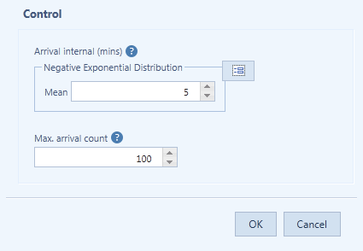
Arrival Interval Time - Statistical Distribution
Once selected, you will be able to set the parameters of the distribution
In the following image the time between generation of tokens instances is exponentially distributed with mean equals to 5 minutes
Tokens will be generated until 100 are reached

Slide 54
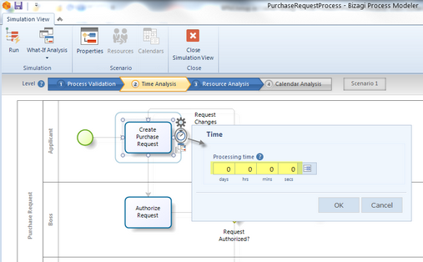
Processing Time
Processing times:
Defines the amount of time an Activity or Event needs to process a token
That is, it defines a service time period from the moment a token arrives at an Activity or Event until it is executed
Click the Activity or Event. Select the Clock on the pie menu, and enter a processing period in the Time Control

Slide 55
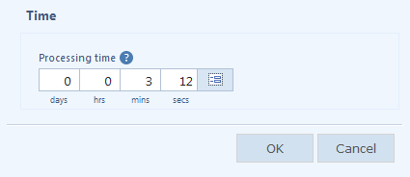
Processing Time - Constant
You have the option of defining the processing time as a constant by entering values in the corresponding units.

Slide 56
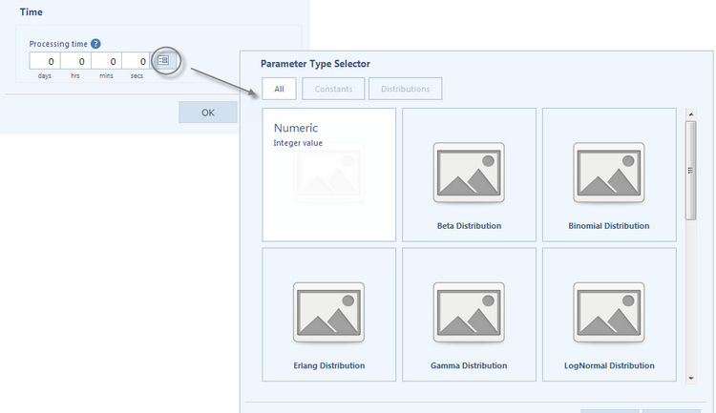
Processing Time - Statistical Distribution
Alternatively, define a statistical distribution. Click the advanced icon alongside the field to view and select a distribution

Slide 57
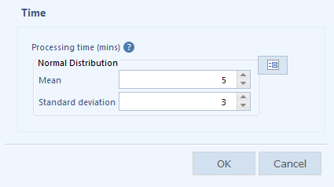
Processing Time - Statistical Distribution
Once selected, you will be able to set the parameters of the distribution
In the following image the processing time of a token in a specific activity is normally distributed with mean 5 minutes and standard deviation of 3 minutes

Slide 58
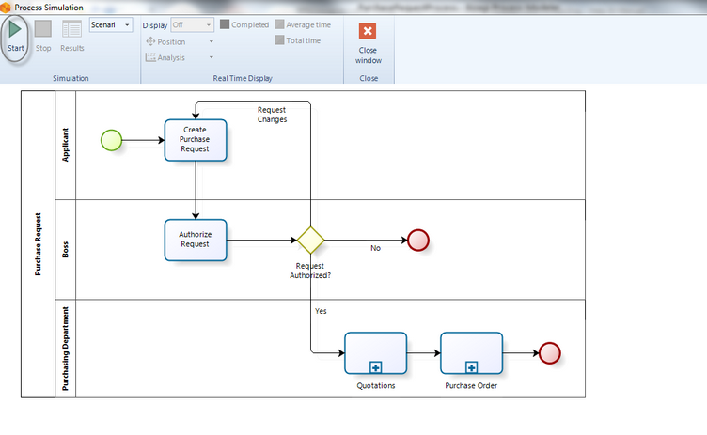
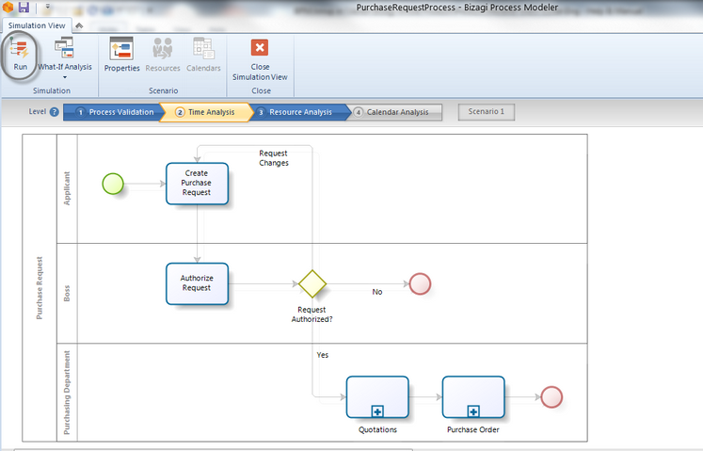
2. Running the simulation

Slide 59
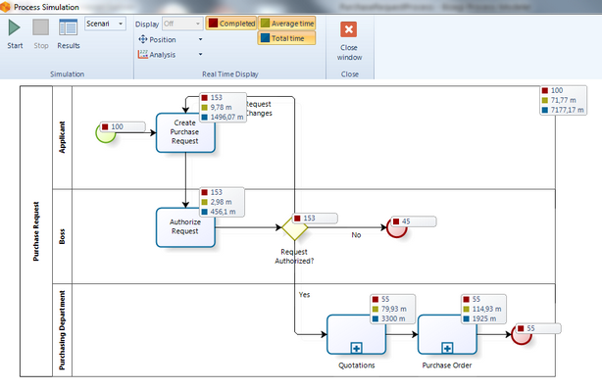
Analysis Data Display
Number of tokens completed
Average time per activity
Total processing time per activity

Slide 60
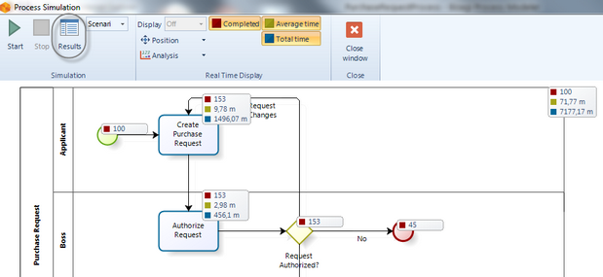
3. Results
When the simulation is complete, select Results to view the outcome

Slide 61
Result Display

Slide 62
Result Display
Name: Identifies the specific BPM shape for which the results are displayed
Type: Identifies the element type of the BPM shape
Tokens completed: Indicates how many tokens were processed (instances)
Tokens started: Indicates how many tokens arrived at the shape
Minimum time: Indicates the minimum processing time of the shape
Maximum time: Indicates the maximum processing time of the shape
Average time: Indicates the average processing time of the shape
Total time: Indicates the total time employed to process the shape

Slide 63
Case Study: Time Analysis for Patient Assistance

Slide 64
Example: Performing a time analysis for the Emergency attendance process
In order to provide a general insight into processing times, the emergency response department has decided to perform a time analysis

Slide 65
Assumptions
Necessary resources to perform activities have infinite capacity
The expected time between reports is 5 minutes
The simulation will evaluate a period of 1 week
The estimated processing times for each of the activities are fixed as shown in the next table:
Activity | Processing time (min)
Receive emergency report | 4
Classify Triage | 5
Manage patient entry | 11
Pick up patient | 20
Arrive at patient place QAV | 7
Arrive at patient place BA | 10
Authorize entry | 4

Slide 66
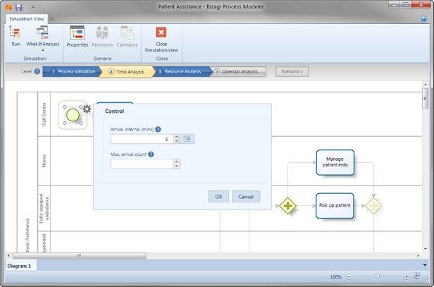
1. Define Trigger Times
To do so, click the Start Event and then the Gear icon on the pie menu
For this example, the expected time between reports is 5 minutes, so set the time to this value
Note the value entered is in minutes

Slide 67
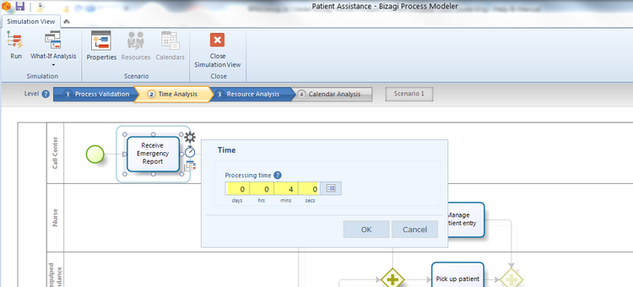
2. Define the Activities' processing times
Click the Activity, select Clock on the pie menu and set a value for the Time control
In the following image the processing time for the first activity is set to 4 minutes

Slide 68
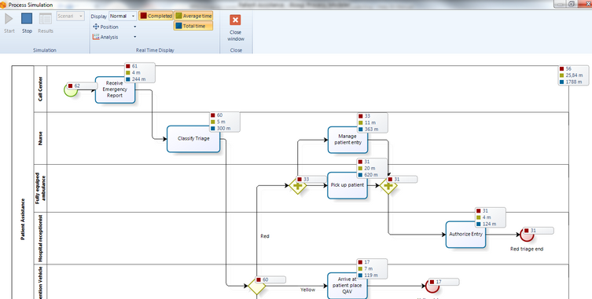
3. Run the Simulation
The simulation shows analysis findings for each shape in real time as it executes, such as average time, total processing time and the number of completed tokens

Slide 69
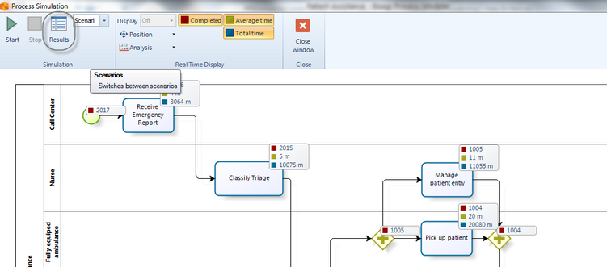
4. Select Results to View the Outcome

Slide 70
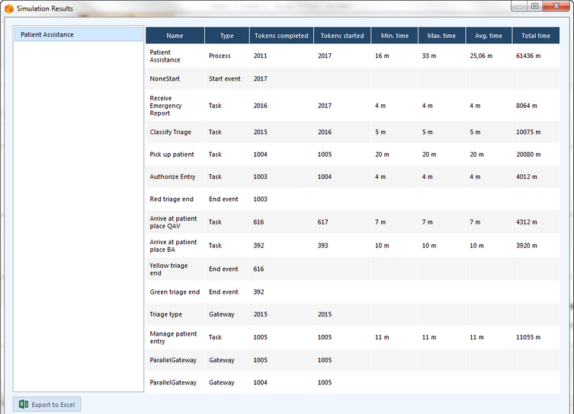
5. Analyzing the results
A patient waits at least 16 minutes before receiving medical attention
A patient waits no more than 33 minutes for medical attention
The expected time a patient waits to receive medical attention is 25,06 minutes

Slide 71
3.4 Resource Analysis

Slide 72
Overview
This analysis shows the potential effect of resource constrains on process performance.
Remember that a Resource is defined as a person, equipment, or space necessary for the execution of a specific task
In the previous level, Time Analysis, we assumed infinite resource capacity, that is, activities are able to process infinite quantity of tokens at the same time. However this assumption is not practical at all. In real terms there are always resources constraints
The most common issue arising from introducing resources constraints is that tokens need to wait to be processed at a given moment
This results in bottlenecks and increase in cycle time, thereby reducing the capacity of the process
Money is another resource directly or indirectly involved in a process
Consequently, this level also allows you to analyze your business operation in terms of costs

Slide 73
Overview
The purpose of this analysis is to identify and minimize the impact of these constraints
in terms of cycle time and costs
The resource analysis results will allow you to evaluate the following performance measures:
Sub- or over-utilization of resources
Total resources costs
Total activity costs
Delays (time an activity waits for a resource)
A more accurate expected cycle time

Slide 74
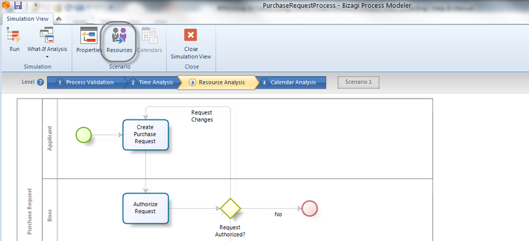
1. Defining the input Data required for this level
By default the Performers defined in the process documentation are defined as resources
In the Resources Analysis level you need to define the following parameters:
Resources: Remember that a resource is a person, equipment or space necessary for the execution of a specific task
To define a Resource click the Resources option found in the ribbon

Slide 75
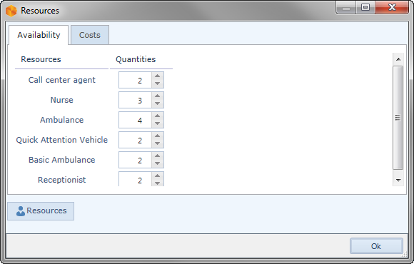
Add Resource
A new window will display the available resources
To add a new resource, click Add resource

Slide 76
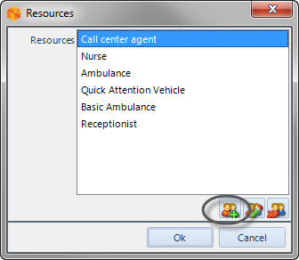
Add Performer
Select Add performer

Slide 77
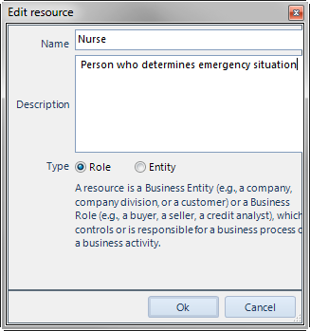
New Resource
Enter the name, description and type of the new resource. Click OK

Slide 78
Availability and costs of resources
To define availability and costs of resources, select the Resources option found in the Ribbon
The availability of Resources determines how many resources of a given type you have as a whole (not for a particular activity)

Slide 79
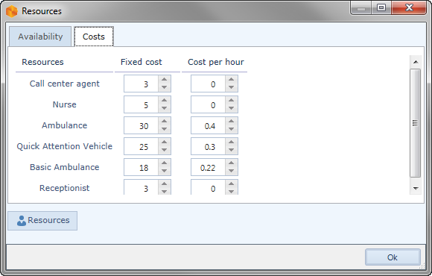
Define the Costs of Resources
To define the costs of Resources, proceed to the Costs tab
You can define the fixed and per hour costs for each Resource
Fixed cost: This cost is generated each time a resource processes a token
Per hour cost: This cost is generated for each hour a resource employs processing a token
The cost units are defined in the scenario's configuration

Slide 80

Resources requirements
Resources Requirements: Tasks require resources to be performed. Once you have defined the process' resources, you have to define how many are required in order to perform a task
To define the Resources requirements for a task, click the task and select the Resource icon in the pie menu

Slide 81

Resource Window
Select the desired resources from the list available in the Resource window
You can select one or more resources
The AND/OR selection mode is available in order to define if all the selected resources are required by the task at the same time or only one at a time

Slide 82

Resource Window
For each resource selected you must define how many of them are used in the task

Slide 83

Activity Costs
Activity costs: The cost of performing an activity, that is, how much an activity costs once executed.
To define the cost of performing an activity, select the Activity and click Cost on the pie menu.

Slide 84

Fixed Cost Amount
Set a fixed cost amount
The cost units are defined in the scenario's configuration

Slide 85


2. Running the Simulation
Once the required data has been entered, click the Run and then Start button to execute the simulation

Slide 86

Analysis Data Display
Resource usage status
Number of tokens completed
Average time per activity
Total processing time per activity
Average waiting time per activity

Slide 87

3. Results
When the simulation is complete, select Results to view the outcome.

Slide 88

For Process and activities
For the Resource Analysis level, the results of the simulated outcome will contain the following information for Process and Resources

Slide 89
For Process and activities
Name: Identifies the specific BPM shape for which the results are displayed
Type: Identifies the element type of the BPM shape
Tokens completed: Indicates how many tokens were processed for each specific BPM shape
Tokens started: Indicates how many tokens arrived at the shape
Minimum time: Indicates the minimum processing time at the shape
Maximum time: Indicates the maximum processing time at the shape
Average time: Indicates the average processing time at the shape
Minimum time waiting resource: Indicates the minimum time a task had to wait for a resource
Maximum time waiting resource: Indicates the maximum time a task had to wait for a resource
Average time waiting resource: Indicates the average time a task had to wait for a resource
Standard deviation: Indicates the standard deviation of the average time a task had to wait for a resource
Total fixed cost: Indicates the total cost of performing a task during execution of the simulation

Slide 90

For Resources
Usage: Indicates the percentage of time the resource was busy
Total fixed cost: Indicates the fixed component cost of using the resource
Total unit cost: Indicates the variable component cost of using the resource

Slide 91
Case Study: Resource Analysis for Patient Assistance

Slide 92
Example: Performing a resource analysis for the Patient Assistance
Assumptions:
The expected time between reports is 5 minutes
The simulation will evaluate a period of 1 week
Resources can be shared between activities

Slide 93

1. Define the resources involved in the process
Create the necessary resources from the Resources option

Slide 94
2. For each resource define the available quantity, fixed cost and unit cost.

Slide 95
Resource, Quantity and Cost
Resource | Quantity | Fixed Cost (US) | Unit Cost (US)
Call center agent | 2 | 3 | 0
Nurse | 2 | 5 | 0
Fully equipped ambulance | 4 | 30 | 0,4
Basic ambulance | 2 | 25 | 0,3
Quick attention vehicle | 2 | 18 | 0,22
Receptionist | 2 | 3 | 0

Slide 96

3. Define the resources requirements for each activity
Click the activities and then the Resources icon. Set the resource and number of instances to perform the activity.
For example, here we are defining that the second activity requires a nurse in order to be performed.

Slide 97
Quantity of Resources for Each Activity
Activity | Resource | Quantity
Receive emergency report | Call center agent | 1
Classify Triage | Nurse | 1
Manage patient entry | Nurse | 1
Pick up patient | Fully equipped ambulance | 1
Arrive at patient place QAV | Basic ambulance | 1
Arrive at patient place BA | Quick attention vehicle | 1
Authorize entry | Receptionist | 1

Slide 98
4. Finally, define the cost of performing each activity
Click the activity, select Cost and enter the corresponding cost
Here we are defining the the cost of performing the Manage patient entry activity is 1 dollar. This cost is related to paperwork and calls.

Slide 99
Cost of the Performance of Each Activity
Activity | Cost (US dollars)
Receive emergency report | 2
Classify Triage | 1
Manage patient entry | 1
Pick up patient | 0
Arrive at patient place QAV | 0
Arrive at patient place BA | 0
Authorize entry | 1

Slide 100
Processing Times for Each of the Activities
Activity | Processing time (min)
Receive emergency report | 4
Classify Triage | 5
Manage patient entry | 11
Pick up patient | 20
Arrive at patient place QAV | 7
Arrive at patient place BA | 10
Authorize entry | 4

Slide 101

5. Click Run and Select Start
Note the number of completed Events are displayed
When the simulation is finished, select Results to view the outcome

Slide 102

6. Analyzing the Results
The results of a resource analysis give us a general insight into the cycle time of the process
Consequently, we can identify how the cycle time is affected

Slide 103
Analyzing the Results
Compared with the best case scenario achieved in the previous level, the inclusion of resources constraints has significantly increased the cycle times.
The minimum time remains at 16 minutes but the maximum increased to 657 minutes and now the average is 204,91 minutes
The previous results only had an average waiting time of 25,06 minutes
As is evident, the processing times for each activity have changed. Now, they reflects delays
The highest average processing times are recorded at Classify triage and Manage patient
The average waiting times confirm there is a problem in those activities. Possibly, resources used in them are not enough.

Slide 104
Analyzing the Results
The usage of the resources indicates some sub and over-utilization
For this case we confirm our hypothesis about a possible problem of resources capacity
The nurse who performs the Classify triage and Manage patient reception has a usage of 99,91%
This means she is utilized at full capacity and tokens have to wait until she becomes available
The emergency department should consider increasing the number of triage nurses to reduce service and waiting times, and thereby reducing the cycle time

Slide 105

Analyzing the Results

Slide 106

Analyzing the Results
We'll see if the situation gets better including a new nurse in the available resources. Now we would have three nurses. Click Run to simulate the new scenario

Slide 107
Analyzing the Results
Introducing another resource brings us closer to the best case scenario with no process delays. The minimum time remains at 16 minutes, the maximum now becomes 35 minutes and the average 25,26
The results also show waiting times close to 0 in the activities where they exist. The current resources are sufficient to avoid critical delays

Slide 108

Analyzing the Results
Usages are acceptable. Nurses now have a utilization of 69,88%.
From the resources cost perspective, there was a total cost of 84.163 US
The new cost of 86.986 US includes the additional nurse
The increase of 2.823 US offsets the benefit in reducing the average waiting time to 179,5 minutes.
There may be other ways to reduce the cost even further and to improve resource utilization, but for now we can accept the state of affairs

Slide 109
3.5 Calendar Analysis

Slide 110
Overview
In addition to the resources constrains discussed in the previous level, we should also consider the effect of resources availability over time to obtain a better understanding of true process performance
In real scenarios, processes are subjected to ever changing conditions in the availability of resources. Holidays, weekends, shifts and breaks restrict and define the true performance of a process
This level predicts how a process will perform during dynamic periods of time, such as shifts, days schedules or weeks.
At the end of this level you will obtain more accurate information on:
Sub- or over-utilization of resources
Total resources costs
Total activity costs
Delays (time an activity waits for a resource)
Expected cycle time

Slide 111

1. Defining the input data required for this level
Additional to the information required in the previous level, the following must be defined in the Calendar Analysis:
Calendars: A Calendar defines resource capacity over certain periods of times. They define the schedules, shifts, holidays and other time constraints to reflect the process in real life.
To create a Calendar click the Calendars option. Click Add calendar.

Slide 112
Calendar configuration
Name: Defines the name of the calendar. It should be short and clear in order to allow identifying the period of time it represents. For example night shift, coffee break, lunch hour etc
Start Time: Defines the starting time of the calendar
Duration: Defines the total duration of the calendar
Recurrence Pattern: Defines the frequency with which a Calendar will be repeated
It can be daily, weekly, monthly or yearly
Range of recurrence: Defines the period of time for which the calendar applies
Start of recurrence: Defines start date of the period of time for which the calendar applies
End of recurrence Defines the end date of the period of time in which the calendar applies. It can also be defined in terms of number of recurrences

Slide 113


Slide 114
Calendars Assignment
Additionally in this level, you have to define the availability of resources for each defined calendar
To define the calendars assignment click the Resources option
For each Resource (row) you must define the availability for each calendar (column)
Keep in mind that if you leave a Calendar blank, Bizagi will assume the availability value of a resource is the one defined in the Default Calendar
This calendar includes the same resources availability defined in Level 3 (Resources Analysis)

Slide 115


Slide 116

2. Running the simulation
Once the required data for this level have been defined, click the Run button to execute the simulation
In the new window, click Start to run the simulation

Slide 117
Running the simulation
When running a simulation, the following analysis data will display.
Status of resource usage
Number of tokens completed
Average time per activity
Total processing time for each activity
Average waiting time for each activity

Slide 118
3. Results
When the simulation is complete, select Results to view the outcome. For a calendar analysis , the results of the simulated outcome will contain the following information:
Resources (All resources)
Tab for each Resource

Slide 119
Tab for each Resource
Name: Identifies the specific BPM shape for which the results are displayed
Type: Identifies the element type of the BPM shape
Tokens completed: Indicates how many tokens were processed (instances)
Tokens started: Indicates how many tokens arrived at the shape
Minimum time: Indicates the minimum processing time of the shape
Maximum time: Indicates the maximum processing time of the shape
Average time: Indicates the average processing time of the shape
Total time: Indicates the total time employed to process the shape
Min. time waiting: Indicates the minimum waiting time for the shape
Max. time waiting: Indicates the maximum waiting time for the shape
Avg. time waiting: Indicates the average waiting time for the shape
Standard deviation waiting: Indicates the standard deviation of the waiting time for the shape
Total time waiting: Indicates the total waiting time for the shape
Total fixed cost: Indicates the total fixed cost for the shape

Slide 120
Case Study: Calendar Analysis for Patient Assistance

Slide 121
Example: Performing a calendar analysis for the Patient Assistance
In order to analyze the impact of calendars in the Patient Assistance, the Emergency department has decided to perform a Calendar analysis
The shifts for the process will be as follow:
Resource | Morning shift (6:00 am - 2:00 pm) | Day shift (2:00 pm - 10:00 pm) | Night shift (10:00 pm - 6:00 am)
Call center agent | 2 | 2 | 1
Nurse | 3 | 3 | 3
Fully equipped ambulance | 4 | 4 | 4
Basic ambulance | 2 | 1 | 2
Quick attention vehicle | 1 | 2 | 1
Receptionist | 2 | 1 | 1

Slide 122
1. Create the three calendars (working shifts)
Click the Calendars and add a new Calendar
We are going to create the Night shift. In the Calendar configuration options enter the following information:
Name: Type Night Shift
Start Time: This calendar starts at 10:00 pm (see table above) so this is the start time
Duration: This calendar starts at 10:00 pm and finishes at 6:00 am so the calendar duration is 8 hours
Recurrence Pattern: This calendar is repeated everyday so select Daily and type 1 in the alongside field
Start of recurrence: This calendar applies always so the start date is the same start date of the simulation.
End of recurrence This calendar applies always so it has no end date.

Slide 123

Repeat for Morning and Day Shift Calendars

Slide 124

2. Through the Resources option
Set the availability of resource for each calendar created previously

Slide 125

3. Click the Run button

Slide 126
4. Analyzing the results
Recall that incorporating ever changing conditions in the resource availability gives us a better understanding of true process performance
The results of the calender analysis will reflect this change. Let us analyze them

Slide 127

Analyzing the results

Slide 128
Analyzing the results
The average time a patient waits for assistance suffered a little increase from 25,06 minutes to 25,48 minutes
This is not significant
The increase from 35 to 39 minutes in the maximum time can be explained by the existing waiting times in some of the activities of the process that were not present in the previous level
The Arrive at patient place BA task has a maximum waiting time of 20 min. It could be critical for a patient, however the average waiting time is 0,74 min
It is clear that high waiting times in this task are rare
Despite the presence of waiting times, they are not regarded critical

Slide 129

Analyzing the Results
The highest usage is for the Nurse. Remember that this resource performs two activities in the process: Classify triage and Manage patient entry.
From the Process results we can conclude that the usage of nurses is not at full capacity since the waiting times of the associated activities are not significant
Assigning shifts and resources did not overtly affect the process in general; therefore, we can conclude that the allocation is adequate for our purpose

Slide 130
Reference
Object Management Group, Business Process Model and Notation (BPMN), OMG Document Number: formal/2011-01-04, 2011
Object Management Group, BPMN 2.0 by Example, OMG Document Number: dtc/2010-06-02, 2011
Bruce Silver, BPMN Method and Style Second Edition, Cody-Cassidy Press, 2011
Layna Fischer (edt.), BPMN 2.0 Handbook Second Edition, Future Strategies, 2012
Tom Debevoise, Rick Geneva, and Richard Welke, The Microguide to Process Modeling in BPMN 2.0 Second Edition, CreateSpace, 2011
Bizagi Proses Modeler User Guide, Bizagi, 2012
Bizagi BPM Suite User Guide, Bizagi, 2013
Thomas Allweyer, BPMN 2.0, BoD, 2010

